Slide 1
Web Client Server Programming
Canvas, JavaScript

Slide 2
Code Examples
https://github.com/claraj/week5-examples

Slide 3
Today
Drawing with HTML5 Canvas
Maps with Leaflet.js
Charts with Chart.js
Optional:
Carousels with Flickity.js
Code highlighting with Highlight.js

Slide 4
Canvas

Slide 5
Canvas
Built into HTML5
Drawing, animation, controlled by JavaScript
Used by online games, graphics, charts, visualizations
A <canvas> element is used to contain graphics
You'll use JavaScript to draw the graphics
http://www.w3schools.com/graphics/canvas_intro.asp

Slide 6
First Canvas
In the body of a HTML document, create an empty canvas element. Set height and width, and give it an id
<canvas id="canvas" height="200" width="300"></canvas>
Also in the body, create a script element. Write JavaScript to draw on the canvas here
<script>
let canvas = document.getElementById("canvas");
let context = canvas.getContext("2d");
context.fillRect(20, 20, 100, 100);
context.strokeRect(150, 20, 100, 100);
</script>
Optionally, use CSS to provide an border for the canvas

Slide 7
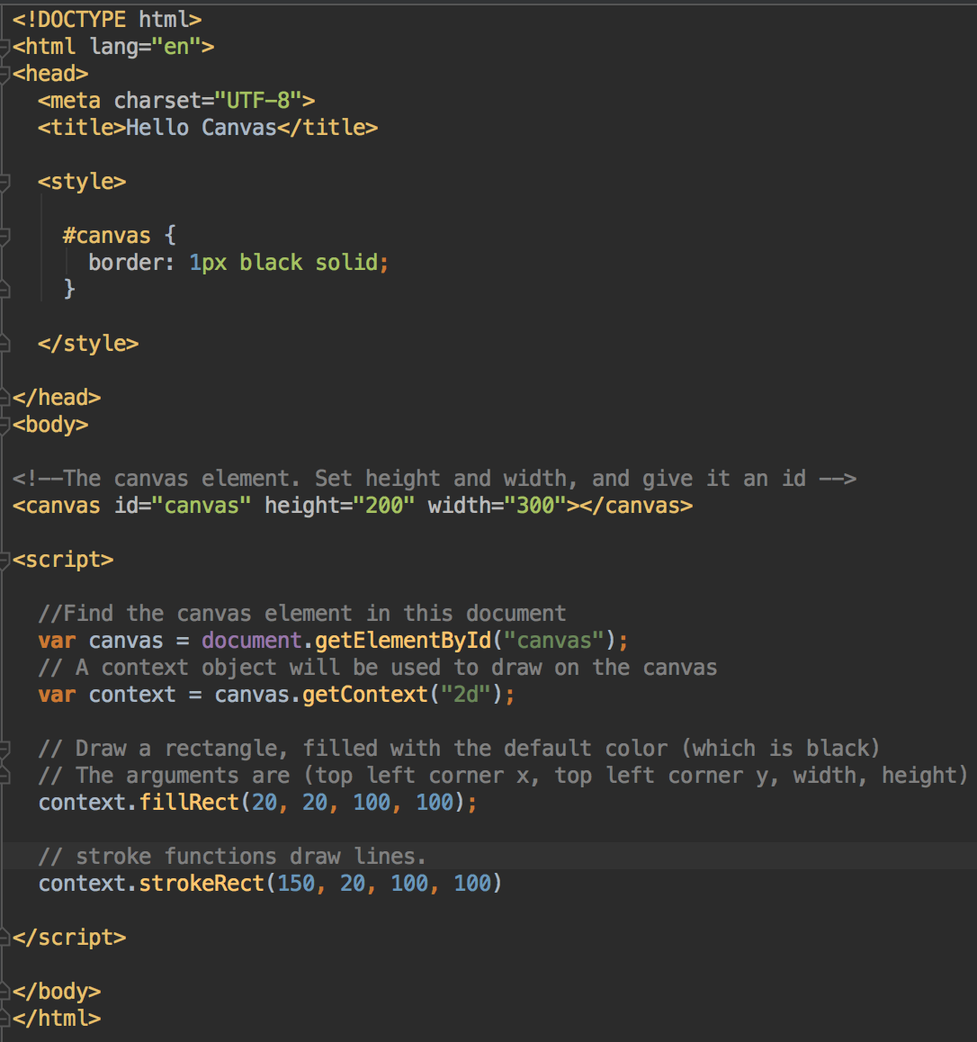
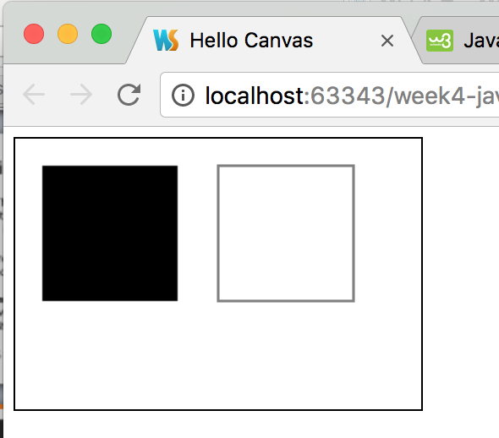
Your turn - drawing squares on a Canvas
canvas/hello_canvas.html

Slide 8
Canvas Coordinates
The origin (0, 0) is the top left
x coordinates increase to the right
y coordinates increase going down
x increases
x = 0, y = 0
x = 0, y = 100
Canvas
width = 100, height = 50
y increases
x = 0, y = 50
x =100, y = 50

Slide 9
Drawing
Can draw rectangles, arcs, lines, text
Set the fill and/or stroke color(s) and styles for the shape
(for lines and arcs/circles) define the coordinates
Call stroke or fill methods to draw

Slide 10
Canvas Fill vs. Stroke
Stroke = draw an outline, or lines
Fill = fill area
Can fill or stroke with HTML color names, or hex color codes (or gradients, or patterns).
Can set line width
Look up hex color codes:
http://htmlcolorcodes.com/color-picker/
HTML/CSS recognized color names:
http://www.w3schools.com/colors/colors_names.asp

Slide 11
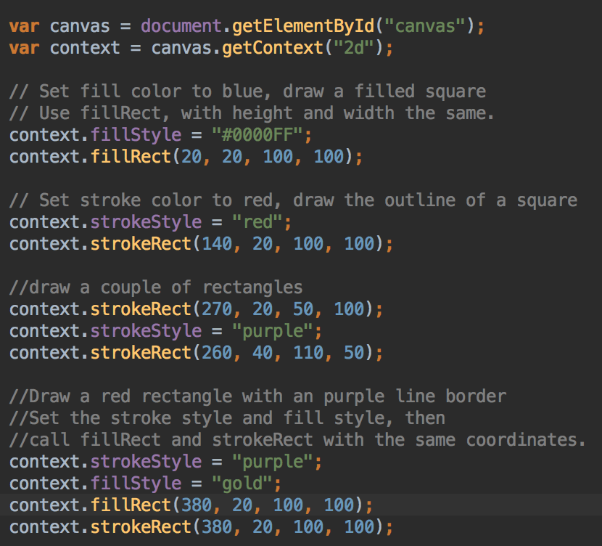
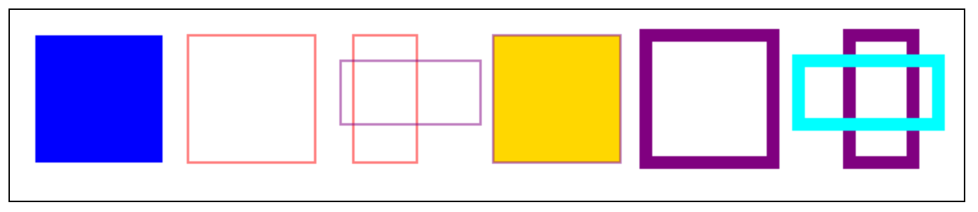
Rectangles
Default stroke is black 1px line, default fill is black
Set stroke or fill
Call strokeRect or fillRect to draw
Your turn: draw some squares and rectangles in colors and sizes of your choice in your canvas
part of canvas/rectangles.html

Slide 12
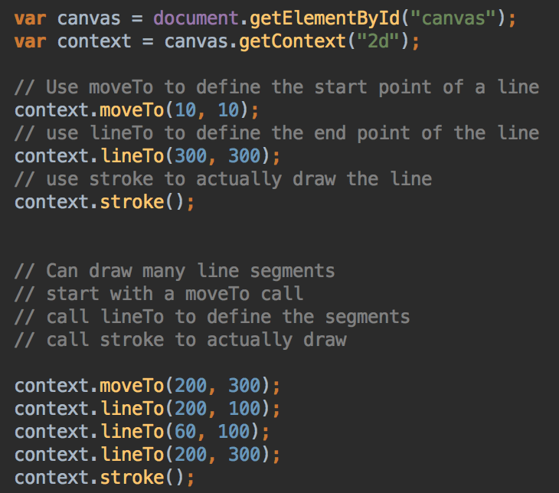
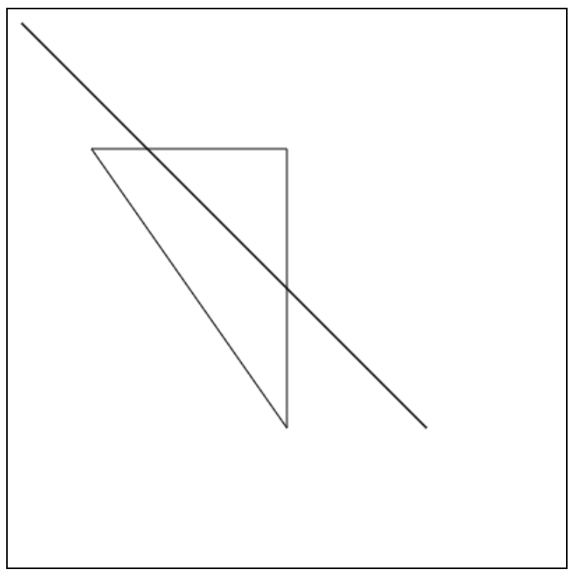
Lines - set stroke color, stroke
canvas/lines.html

Slide 13
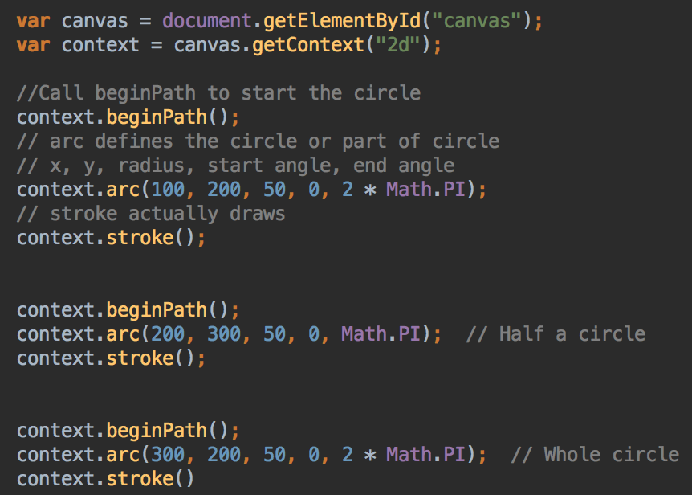

Circles
Use beginPath, arc, stroke
canvas/circles.html

Slide 14
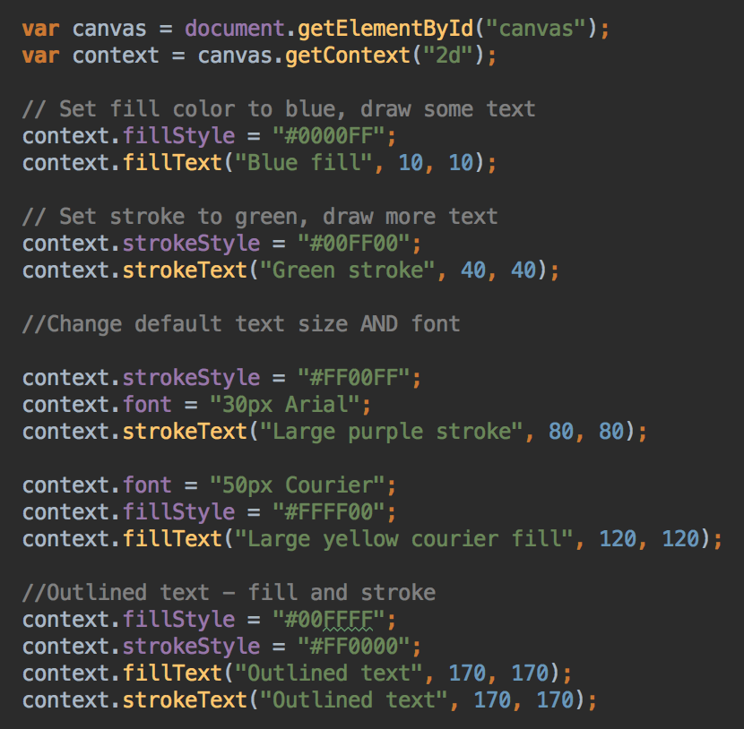
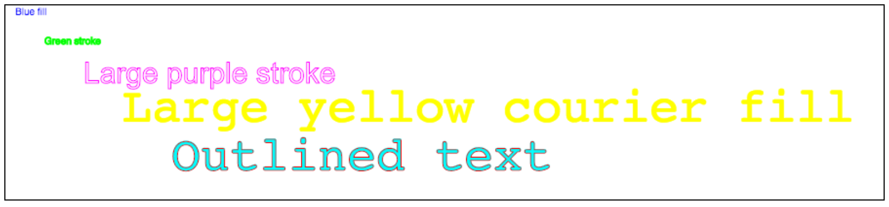
Text
Set stroke, and/or fill
Set text size and/or font
Use fillText or strokeText,
arguments are (the text, x, y)
context/text.html

Slide 15
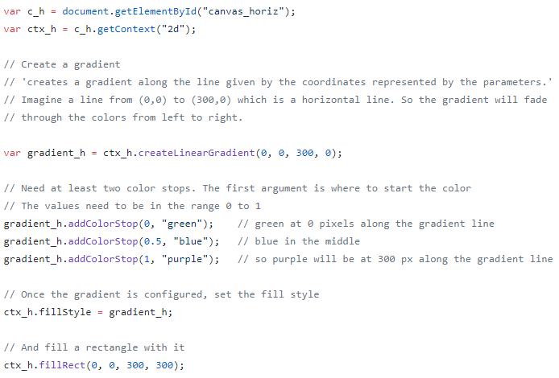
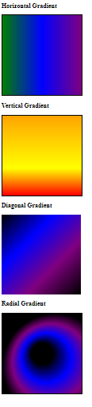
Gradients
Part of /canvas/gradients.html

Slide 16
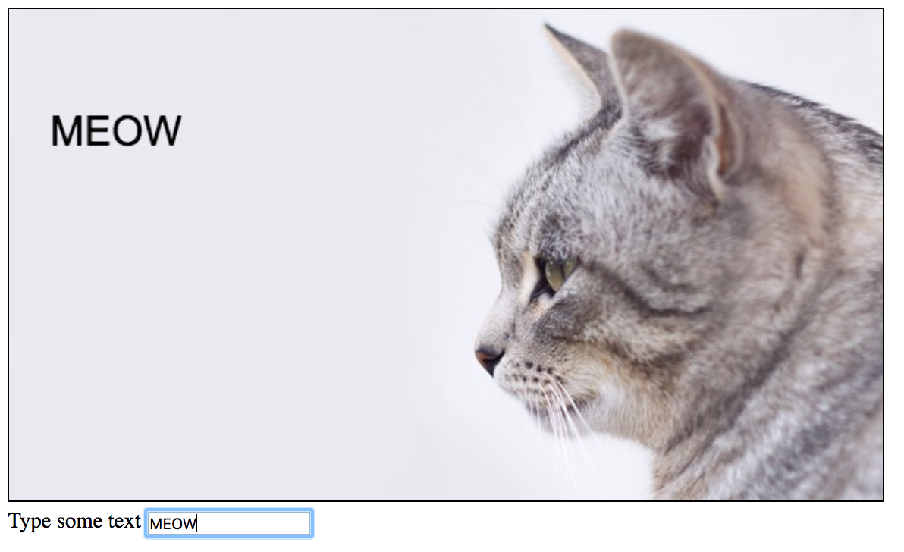
Event listeners, draw image, draw text
See canvas/draw_word.html

Slide 17
Your Turn - User adds text to Picture
Create two files:
draw_word.js
draw_word.html
Download an image file of your choice into your project - something around 500x500 pixels is a good size
JavaScript will be in external file, separate from HTML

Slide 18
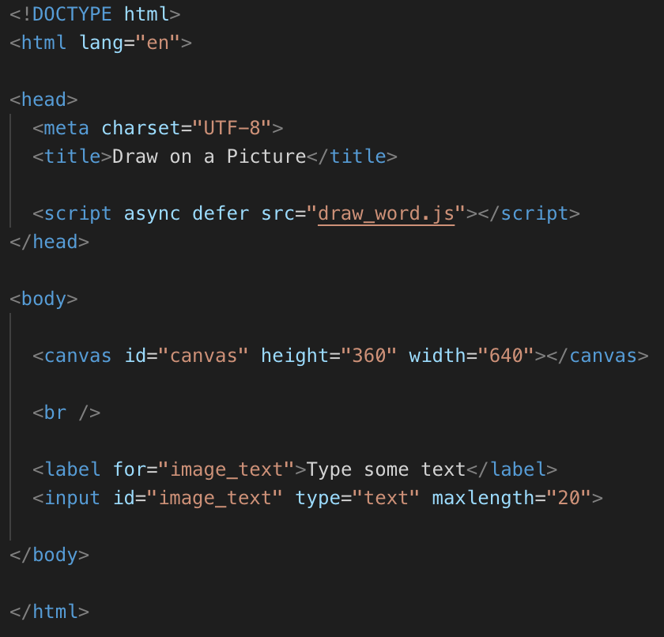
draw_word.html
Add a canvas
Add an input, and a label
Set the canvas height and width to match your image size

Slide 19
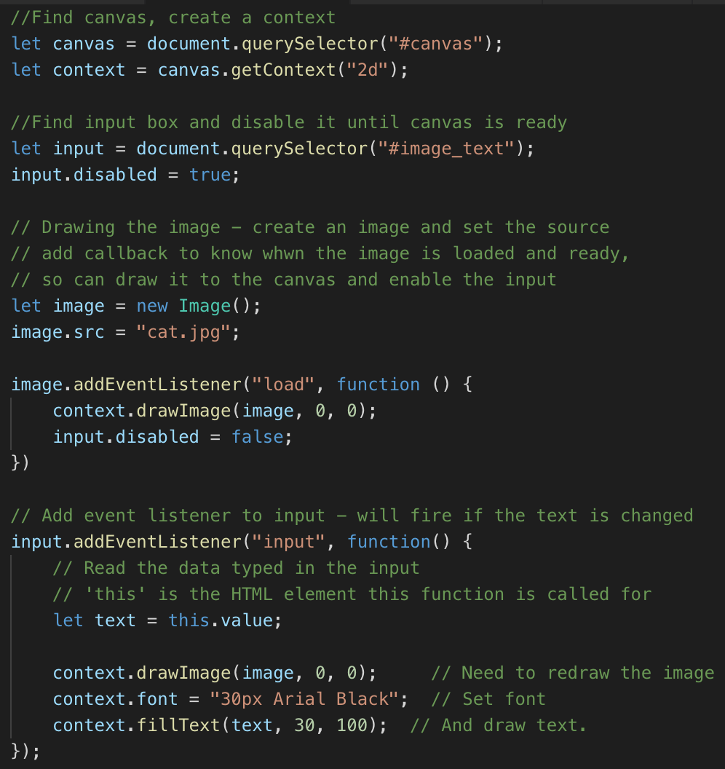
draw_word.js
Get reference to canvas, context, input
Draw the image
Add input event listener: whatever the user types in the input will be drawn on the canvas
Use your own filename
context.font = "40px Arial"
context.fillStyle = "Black"

Slide 20
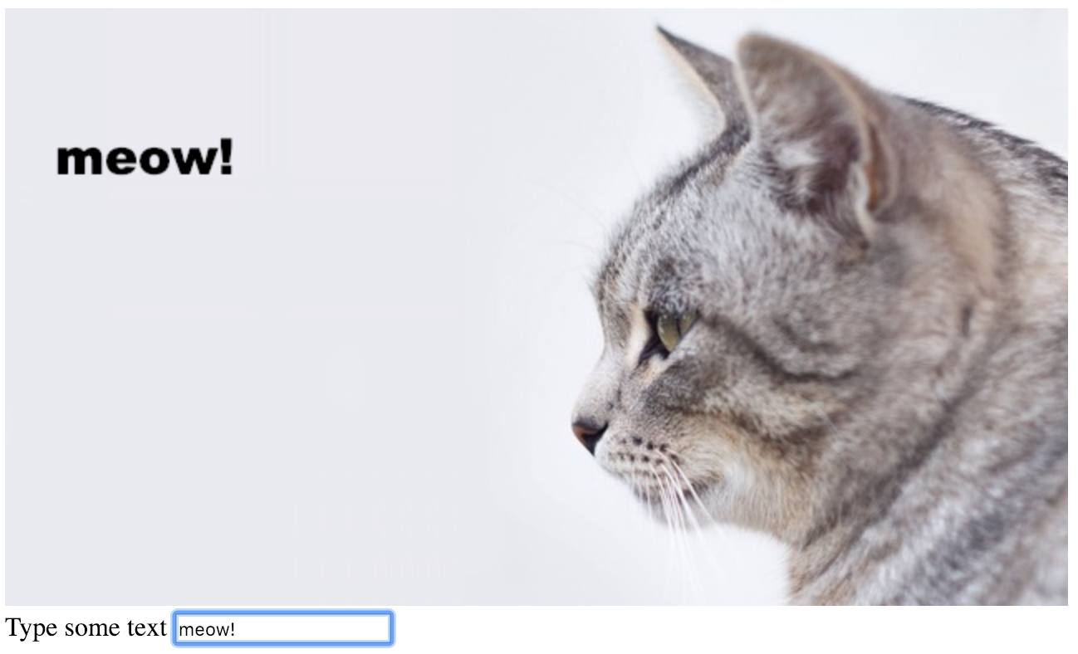
Run and test
Adjust the position of the text to suit your image
You can right-click and save the canvas, with text and image, as a picture to your computer

Slide 21
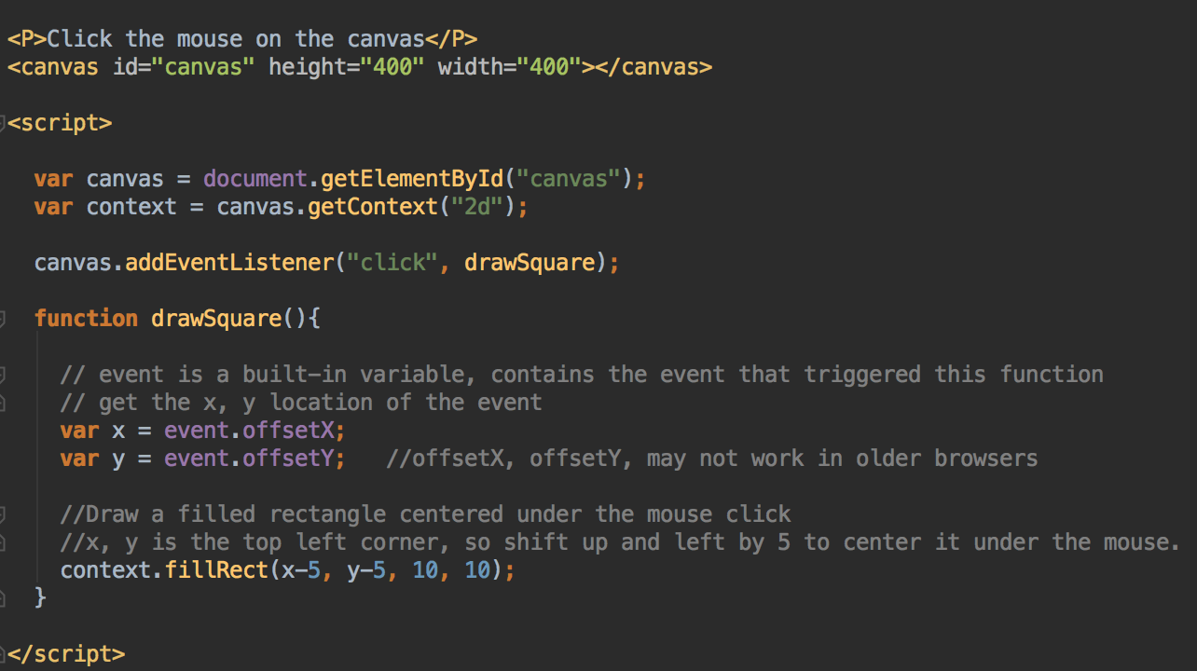
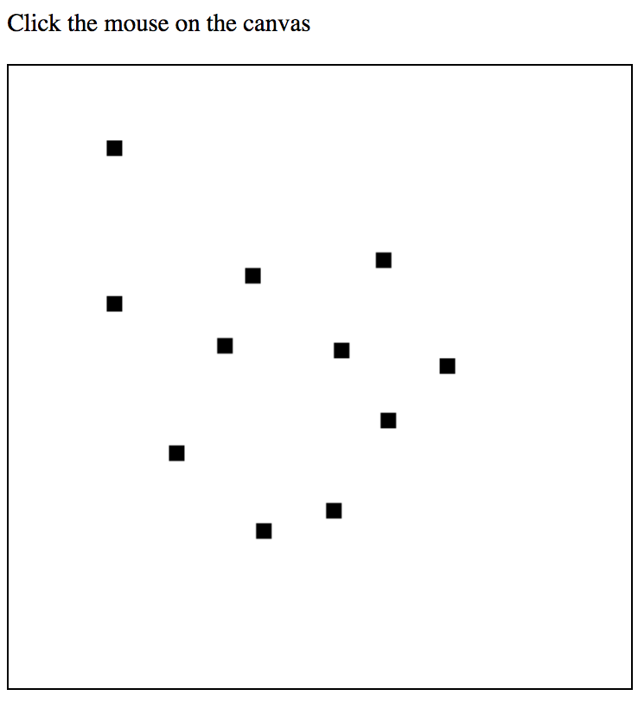
Mouse events
Adding event listeners to a canvas
canvas/mouse_events.html

Slide 22
Your Turn – In Lab
Start with the mouse_drag.html example in the example repo
Build a basic drawing program?
Draw a circle instead of a square
Add a input type = color for the user to select the color to draw
Add a clear button
Bonus question: add a input type=range to select the size of circle drawn

Slide 23
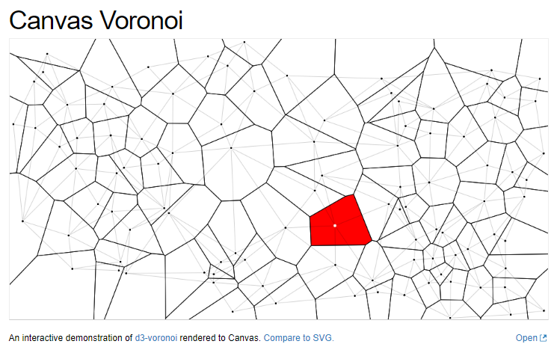
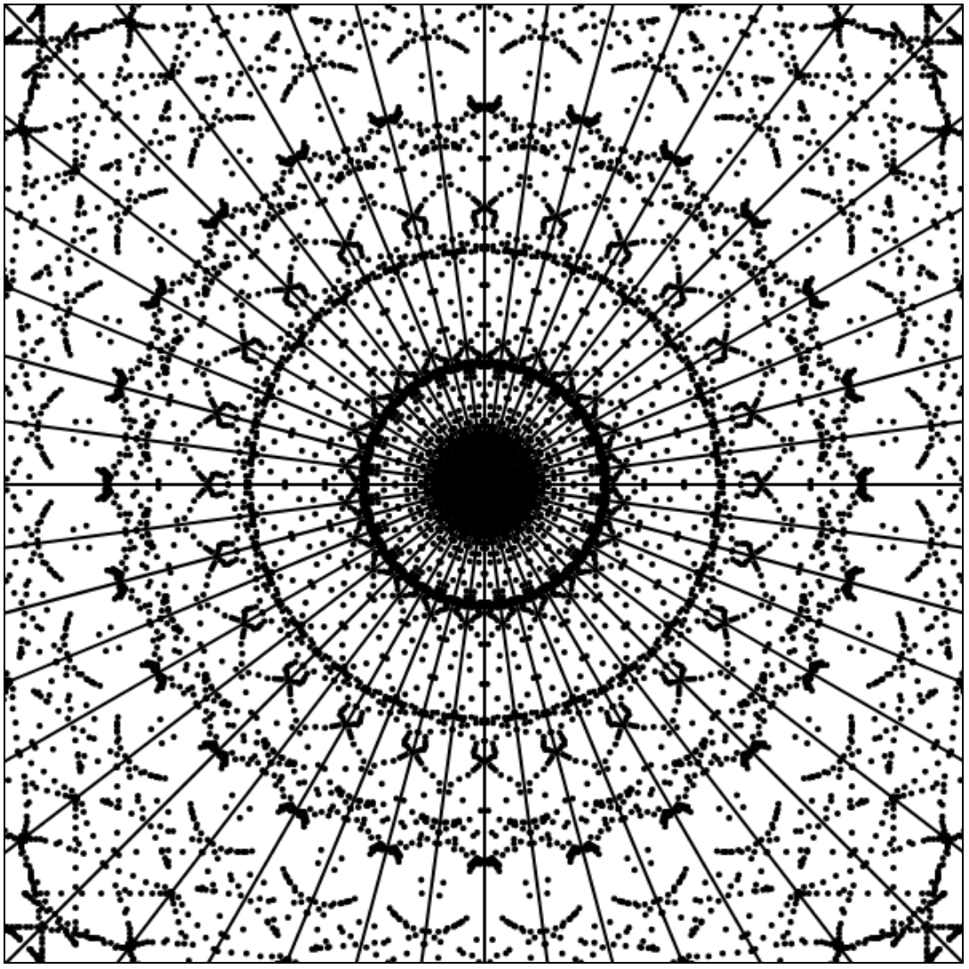
More Canvas Examples
https://bl.ocks.org/mbostock/6675193
https://claraj.github.io/kaleidoscope/

Slide 24
Maps with Leaflet.js

Slide 25

Drawing Leaflet Maps
Link to Leaflet’s CSS and JS
Create a map div, set the size to be non-zero
Use JS to configure and customize the map
https://leafletjs.com/

Slide 26
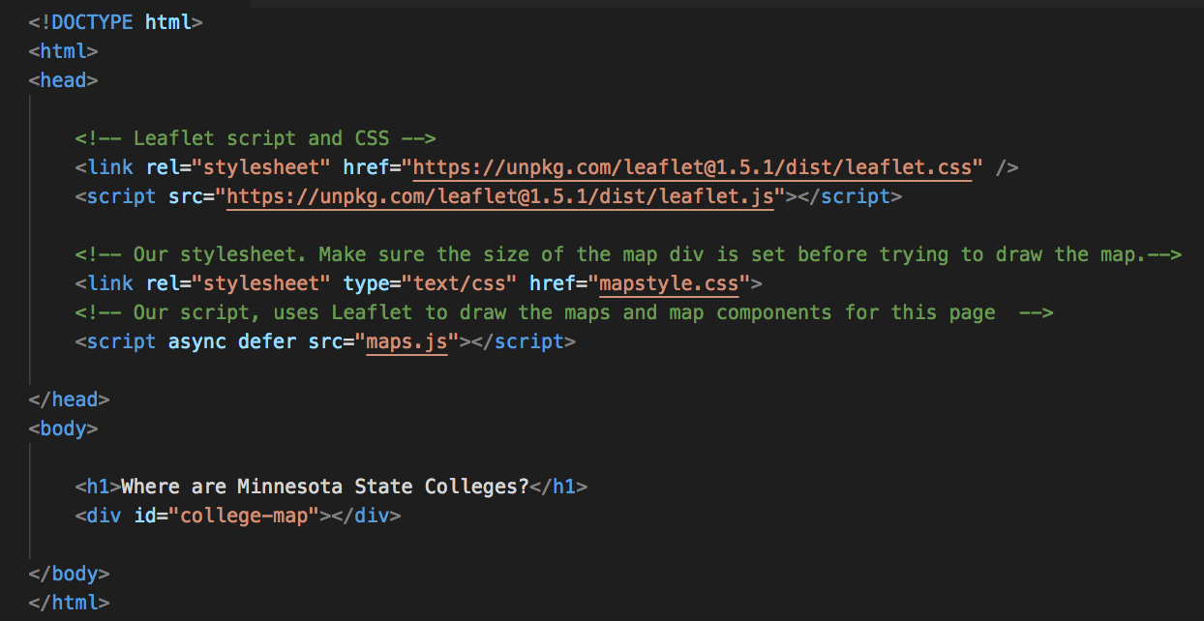
Leaflet.js: Mapping MinnState Colleges
Copy this file from example repository https://github.com/claraj/week5-examples/blob/master/leaflet_maps/hello_leaflet_maps.html
And in the same directory, create two more files
maps.js
mapstyle.css

Slide 27
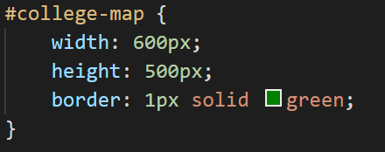
Create stylesheet mapstyles.css
Add these styles to set the size of #college-map div
Set a border with color of your choice
If you need other styles for your page, can add them to this file
mapstyles.css

Slide 28
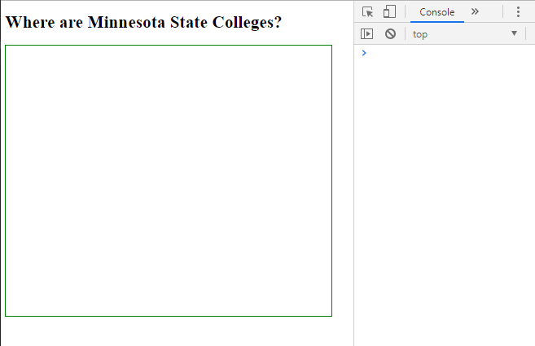
Load your .html file in your browser
Make sure you see the title and empty div rectangle
Verify no errors in dev tools, indicating all the JS and CSS resources have loaded

Slide 29
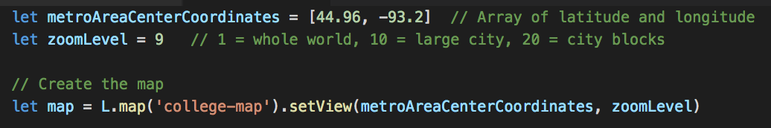
Create script file, maps.js
Create a map, centered on a location, and zoomed to the specified level
But you won’t be able to see anything on your page
The map needs tiles – the map background showing the roads, buildings, rivers, labels….

Slide 30
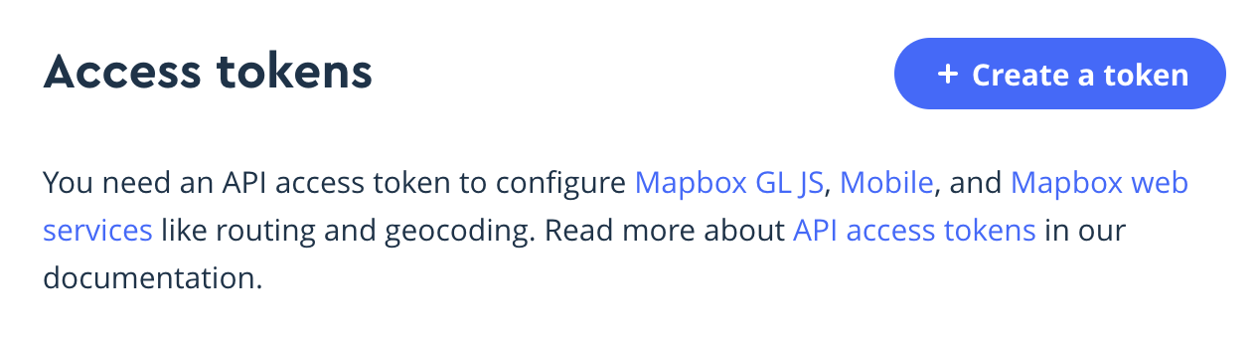
Mapbox
Sign up for a free Mapbox account at
https://account.mapbox.com
Click Create a token, leave the page with the token open

Slide 31
Add this to your script
Copy and paste the following, at the end of your script
L.tileLayer('https://api.tiles.mapbox.com/v4/{id}/{z}/{x}/{y}.png?access_token={accessToken}', {
attribution: 'Map data &copy; <a href="https://www.openstreetmap.org/">OpenStreetMap</a> contributors, <a href="https://creativecommons.org/licenses/by-sa/2.0/">CC-BY-SA</a>, Imagery &copy; <a href="https://www.mapbox.com/">Mapbox</a>',
id: 'mapbox.streets',
accessToken: 'your.token.here'
}).addTo(map)

Slide 32
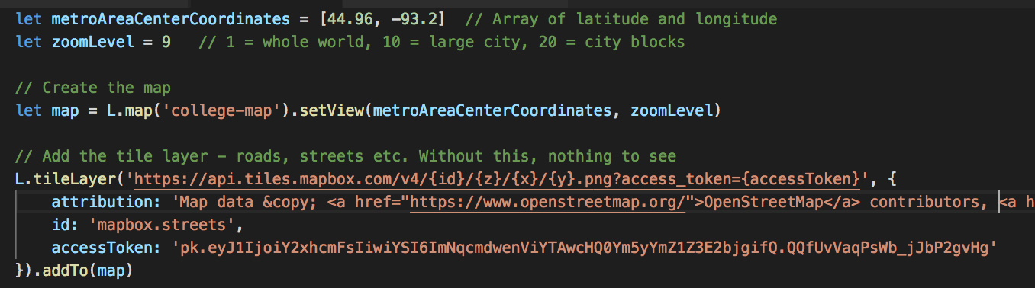
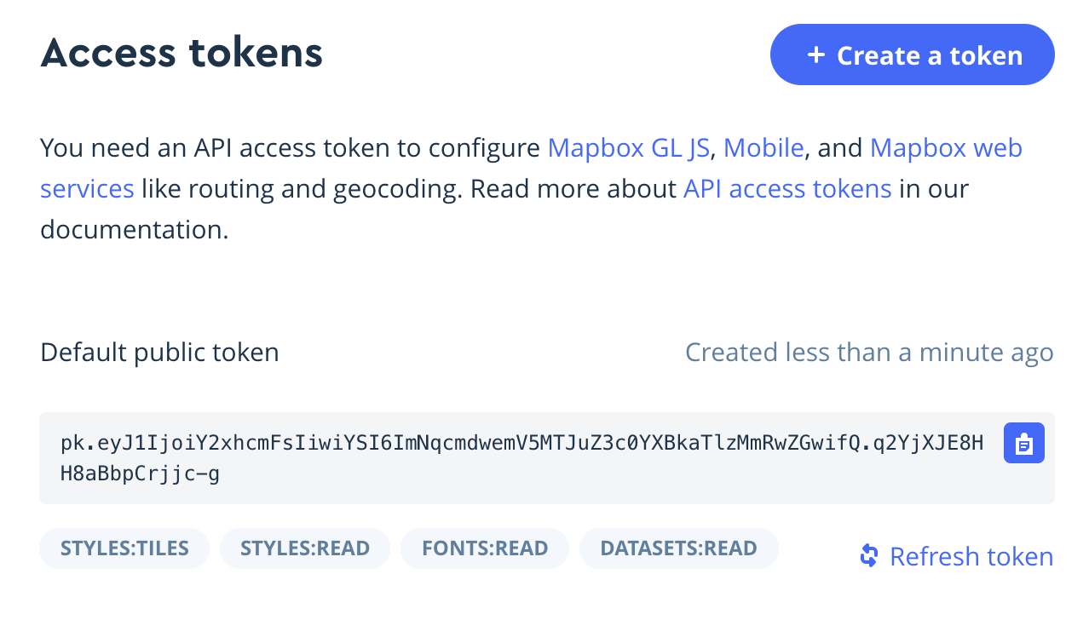
maps.js
Replace 'your.token.here' with your Mapbox token

Slide 33
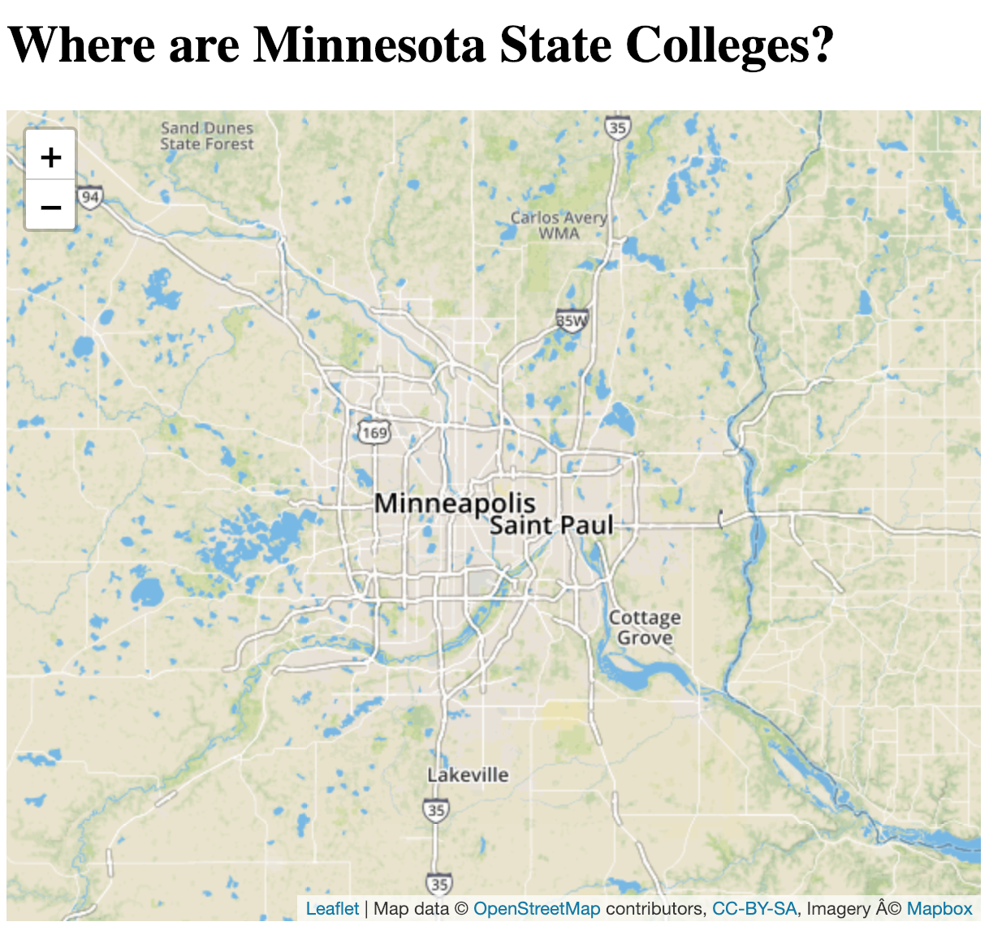
Load page in browser
Your page shows a map, centered on the Twin Cities
No map?
Check dev tools for JS errors
Make sure your div size is set with CSS

Slide 34
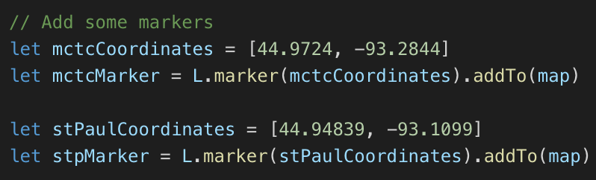
Adding markers
Add this to your script

Slide 35
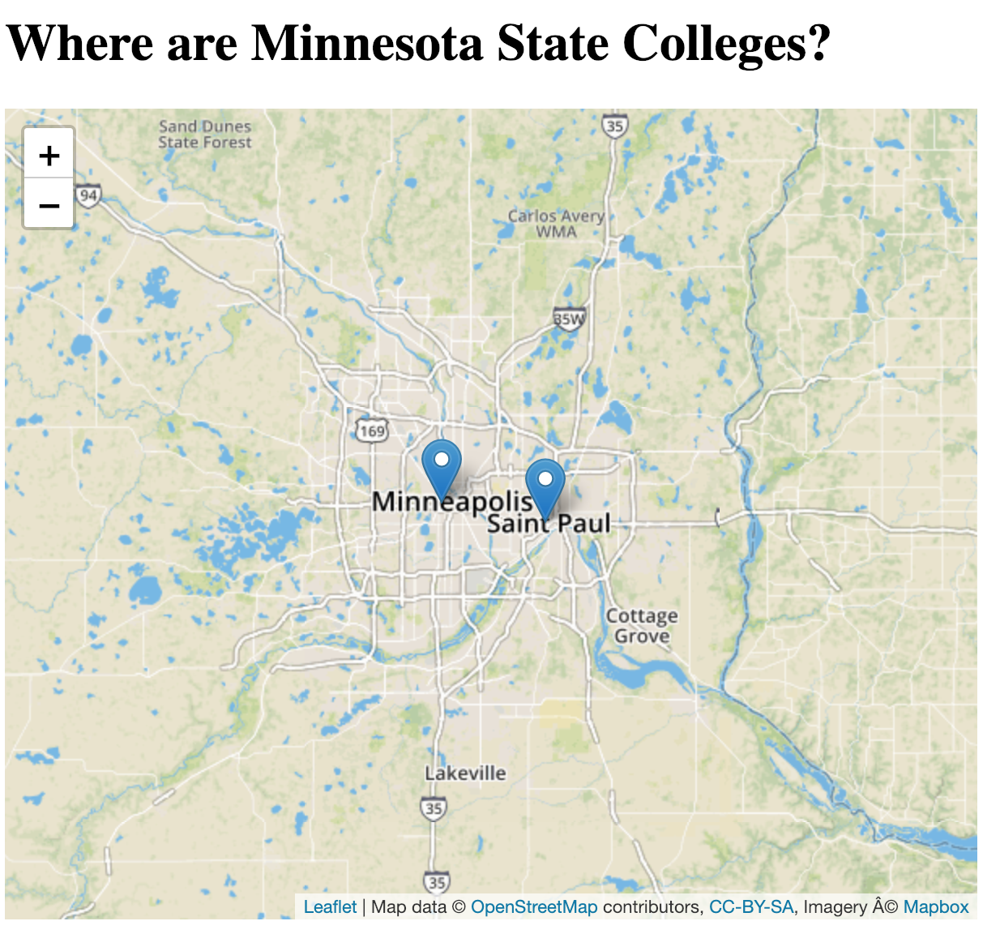
Load page, verify markers shown

Slide 36
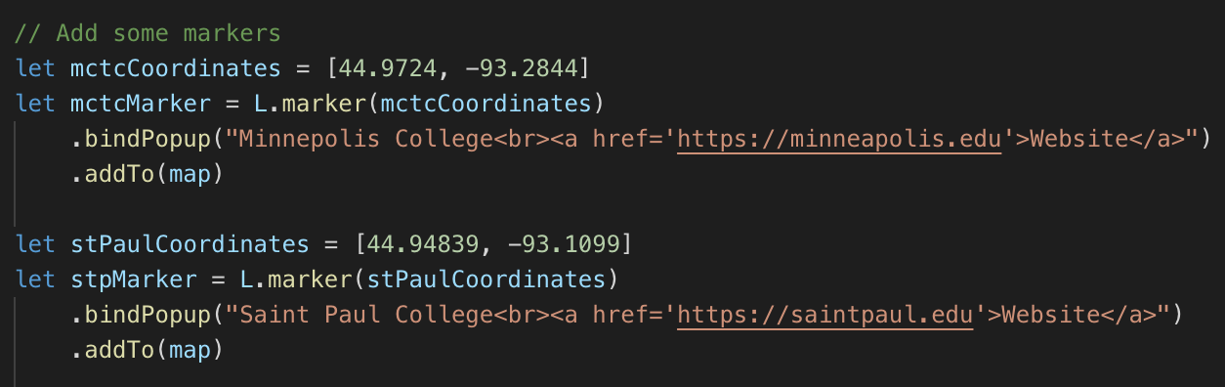
Add popups
Modify markers

Slide 37
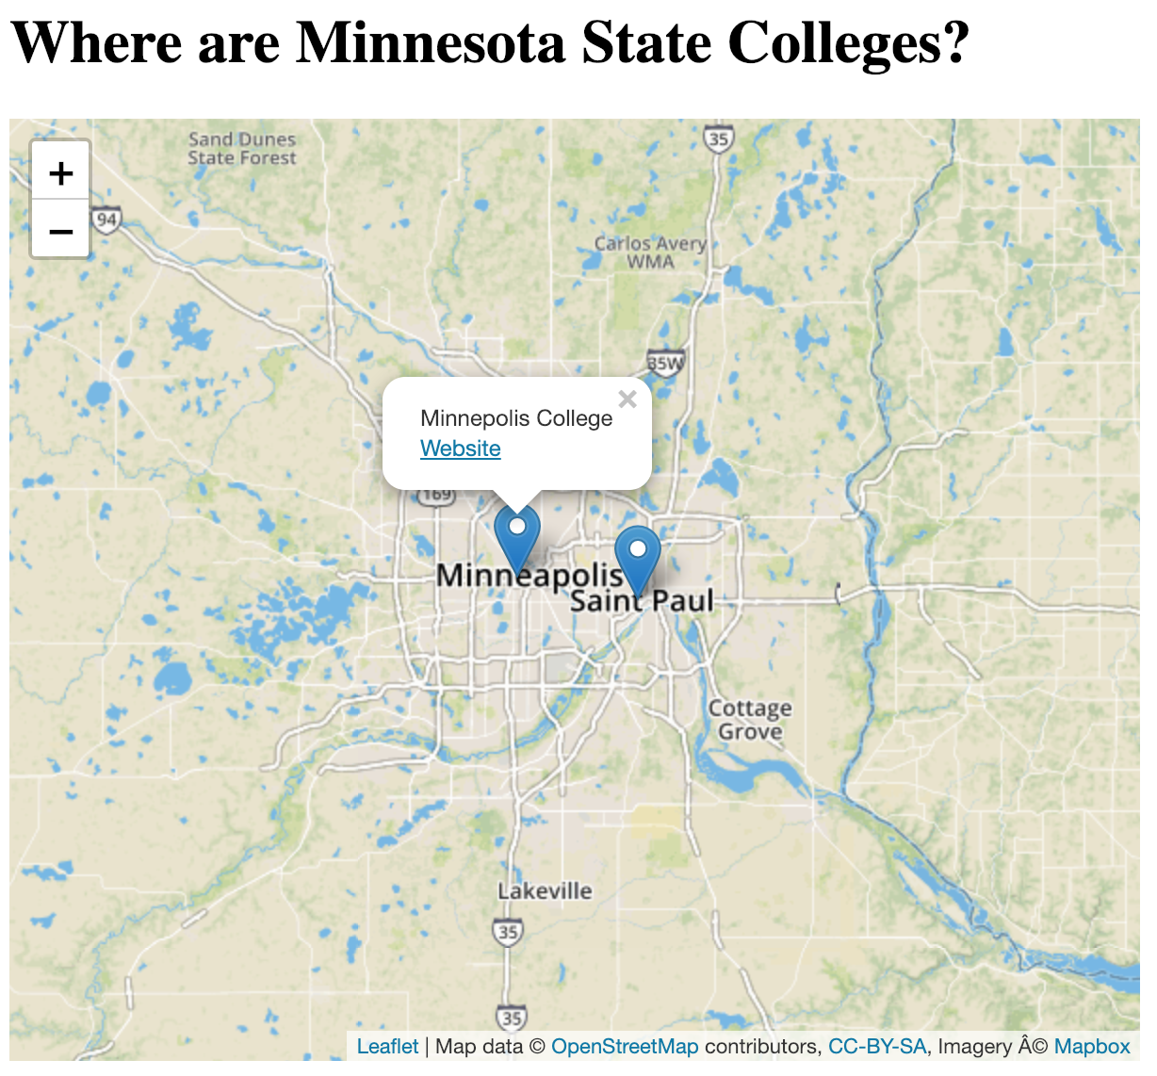
Markers with popups
Click to see popup
Can write HTML in popups
The links should work

Slide 38
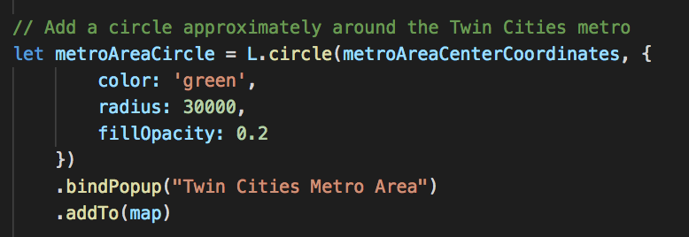
Other annotations
For example, draw a circle
Configure with an object { color: 'green', radius: 30000, fillOpacity: 0.2 }

Slide 39
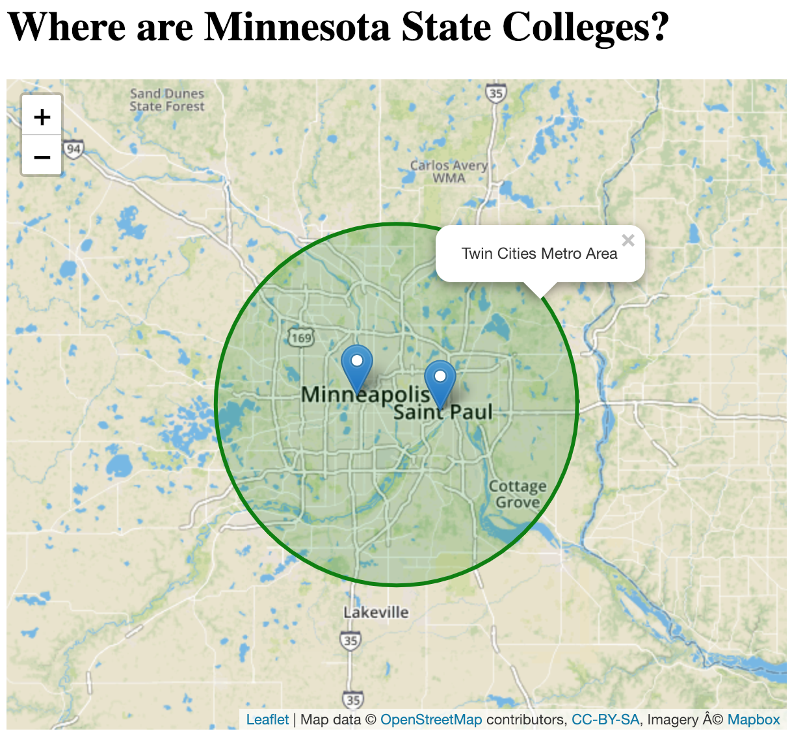
Circle with popup
https://claraj.github.io/week5-examples/leaflet_maps/hello_leaflet_maps.html

Slide 40
Your Turn
Draw a marker for Normandale Community College,
Add a popup, that has a working link to their website
Normandale's latitude and longitude is
[44.8297, -93.3312]
Their website is http://www.normandale.edu/

Slide 41
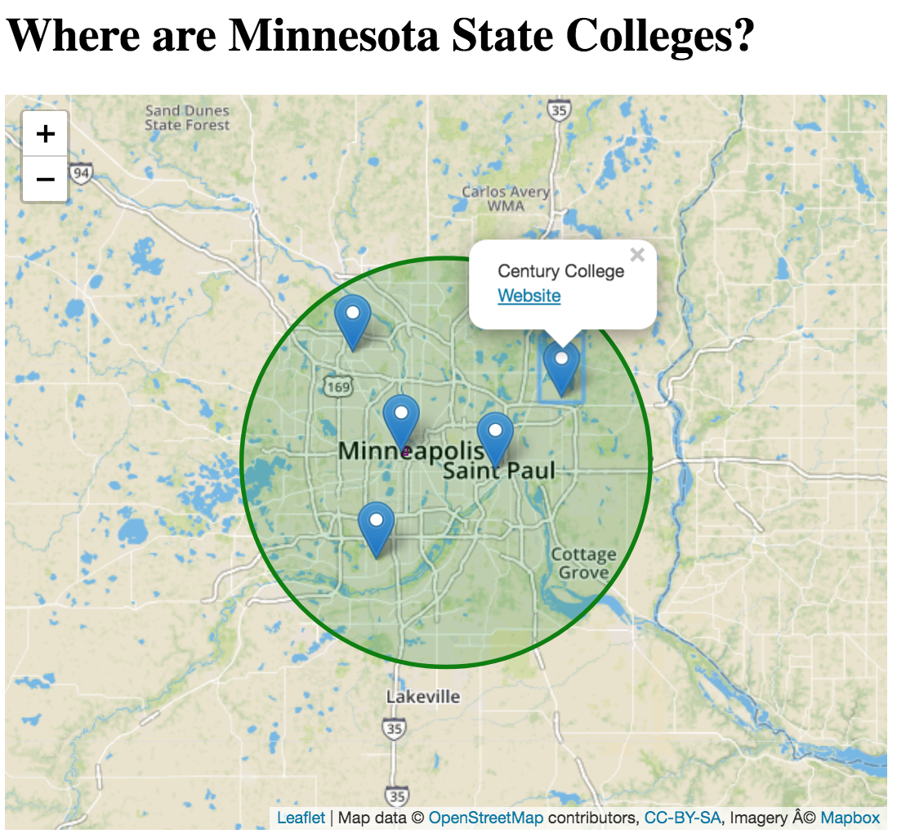
Your Turn
Paste the object below into your script, with names, websites, and locations for five campuses
Write a loop to create all five markers, with popups, and add to the map, like this ->
Remove the code that creates the individual markers
campuses = [
{'name': 'Minneapolis College', 'website': 'https://minneapolis.edu', 'coordinates': [44.9724, -93.2844] },
{'name': 'Saint Paul College', 'website': 'https://saintpaul.edu', 'coordinates': [44.94839, -93.1099] },
{'name': 'Normandale Community College', 'website': 'https://normandale.edu', 'coordinates': [44.8297, -93.3312] },
{'name': 'North Hennepin Community College', 'website': 'https://nhcc.edu', 'coordinates': [45.1054232,-93.3767558] },
{'name': 'Century College', 'website': 'https://century.edu', 'coordinates': [45.0438494,-92.9862026] },
]

Slide 42
Carousels with Flickity

Slide 43
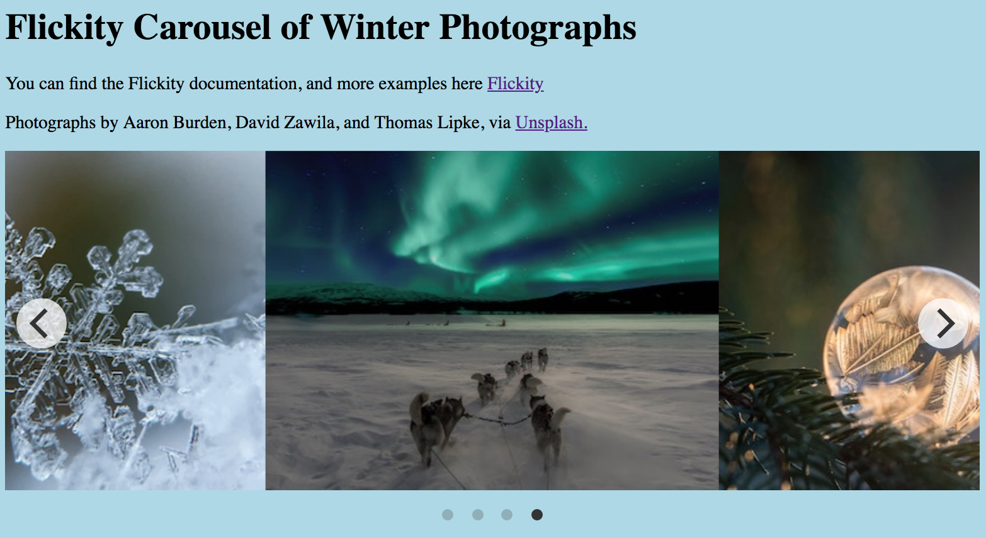
Flickity Carousels
https://flickity.metafizzy.co/
Flikity builds the carousel, you provide the content

Slide 44
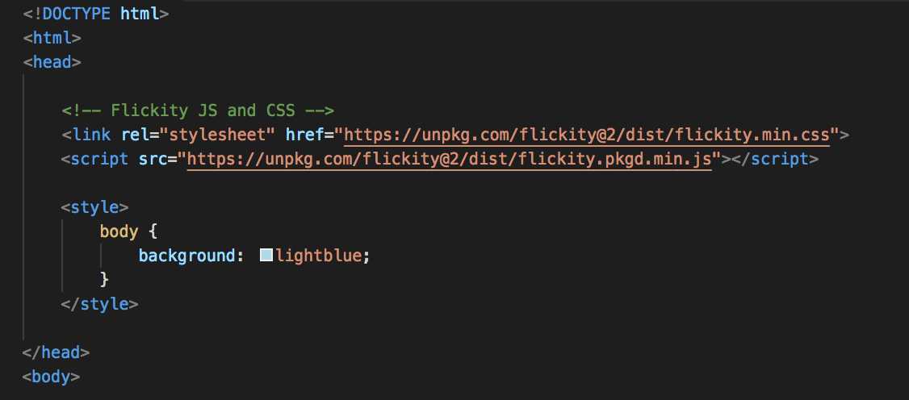
To create a carousel 1. Add Flickity's JS and CSS in head
Get the links from Flickity's website

Slide 45
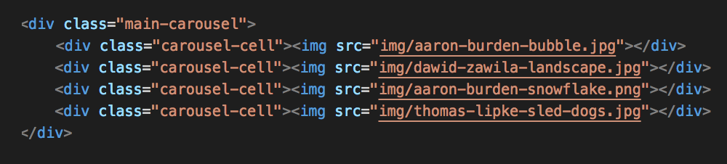
2. Add elements for carousel and content
A div with class="main-carousel"
Put div elements with class="carousel-cell" inside
Add as many cells as you like
Flickity will look for elements with these classes and create a carousel from them

Slide 46
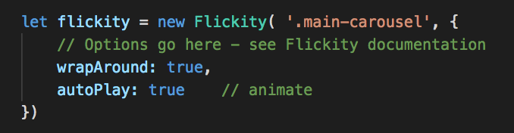
3. Configure carousel with JavaScript
Find the .main-carousel div
Provide options
Full list of options at Flickity's site

Slide 47
Carousel
Displays images
https://claraj.github.io/week5-examples/flickity_carousel/winter_image_carousel.html

Slide 48
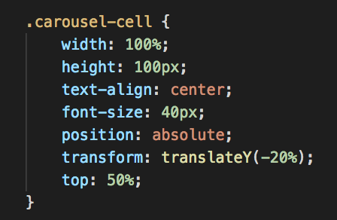
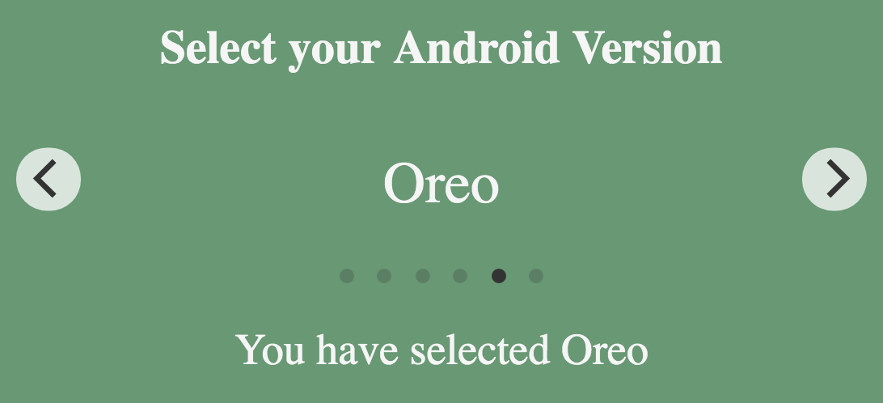
Text Carousels
Many different kinds of content can work in a carousel
For text, may need to set the cell size with CSS
https://claraj.github.io/week5-examples/flickity_carousel/android_version_text_carousel.html

Slide 49
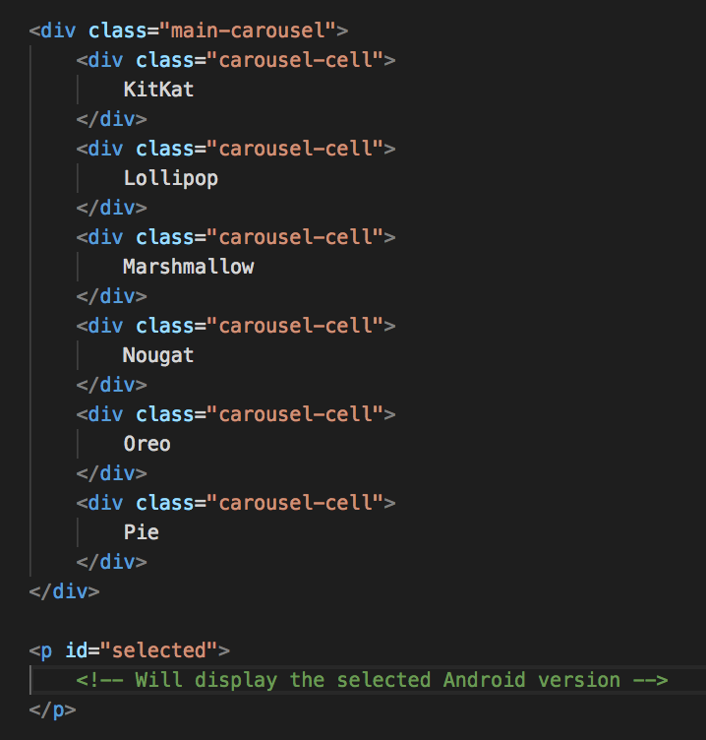
Carousel Elements
Create carousel as before
When you have created a carousel, can listen for the carousel swiped, cells clicked etc.

Slide 50
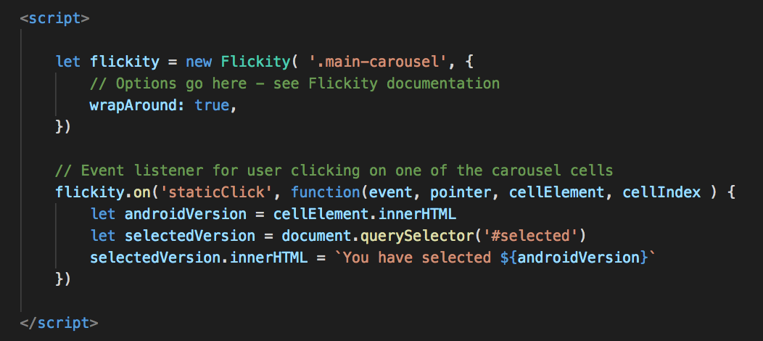
Carousel Events
As before, check Flickity's documentation for the event you want to listen for, and the function definition to provide

Slide 51
Code Highlighting With Highlight.Js

Slide 52
Highlight.js Code Highlighting
https://highlightjs.org/
Just add the scripts and put your code in
<pre><code> …. </code></pre> tags
And call the initialization script
Make sure you include the meta tag to set your document charset to UTF-8

Slide 53
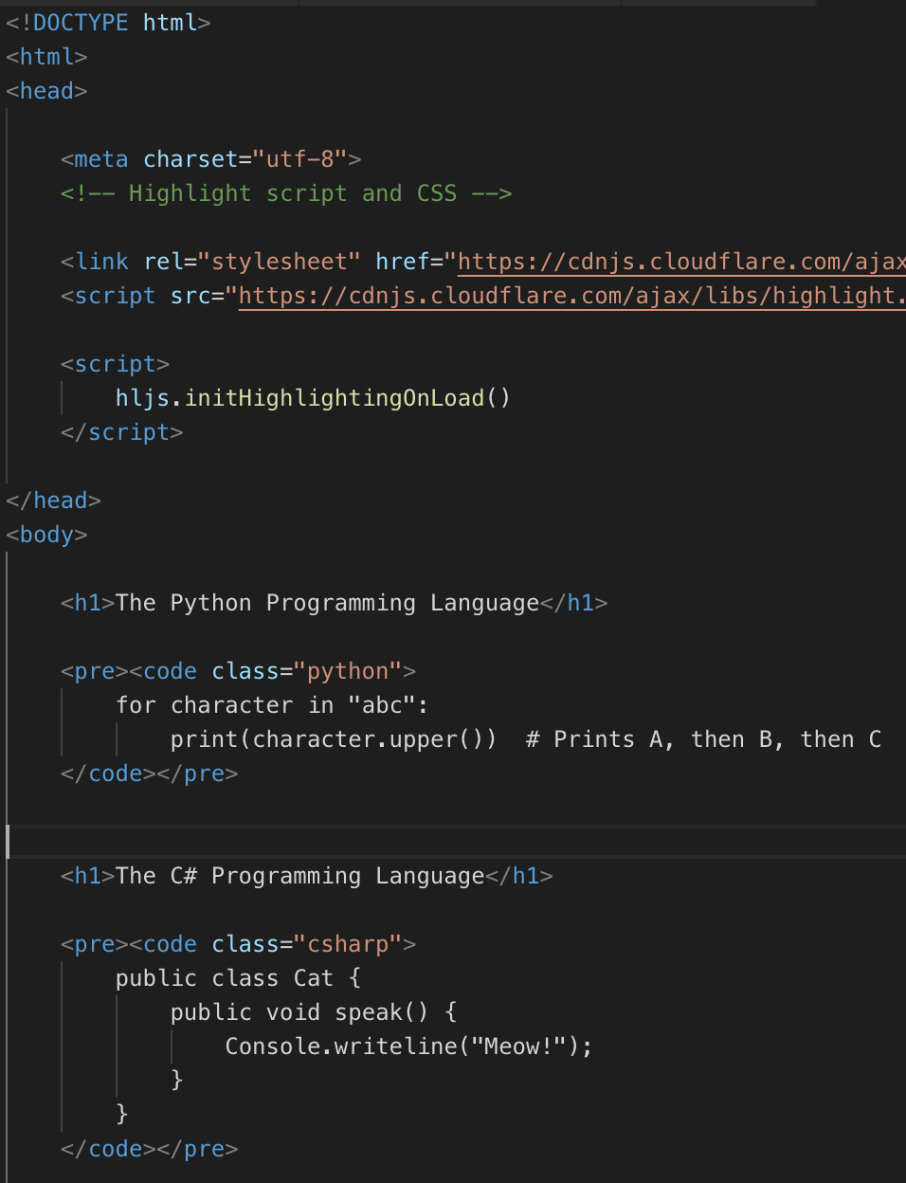
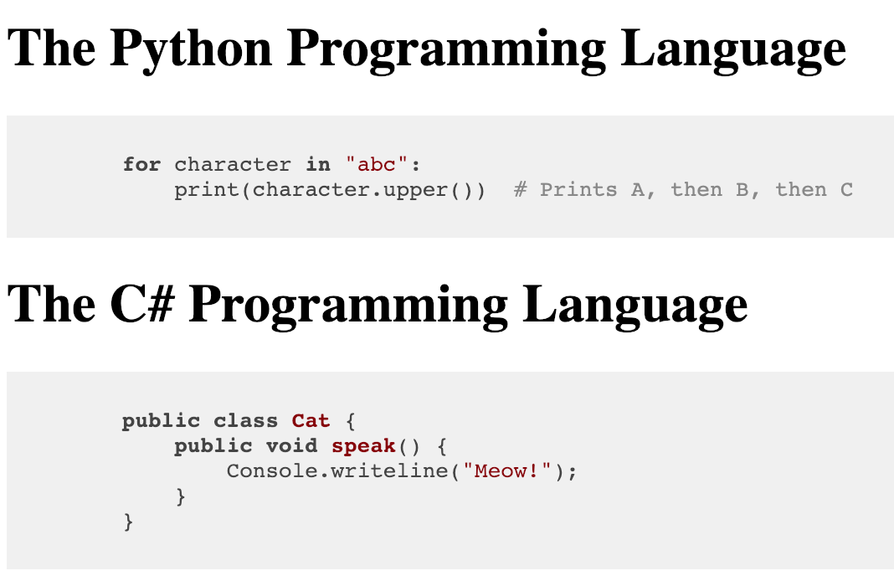
Highlight.js
https://claraj.github.io/week5-examples/highlight_code/code.html

Slide 54
Charts with Chart.js

Slide 55
Chart.js Charts
Similar to Leaflet, except you create a canvas
Create chart with JavaScript

Slide 56
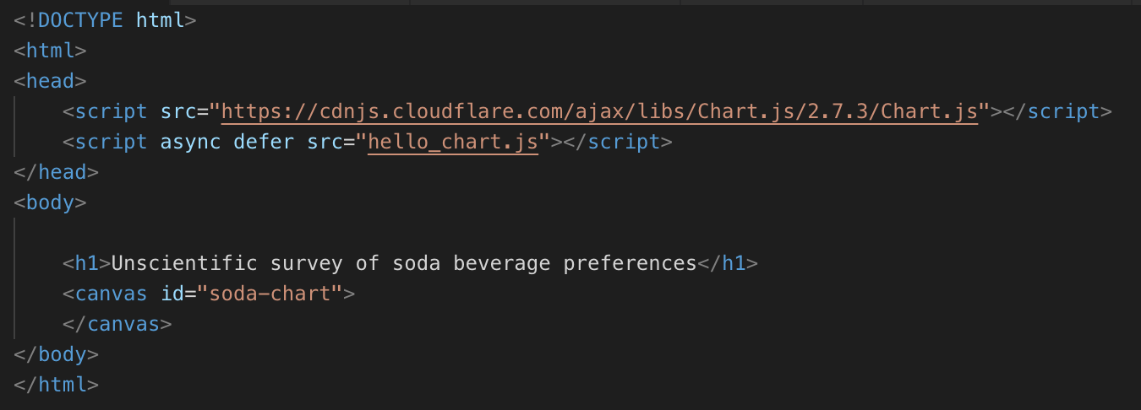
Hello Chart.js
HTML – create a canvas with an id

Slide 57
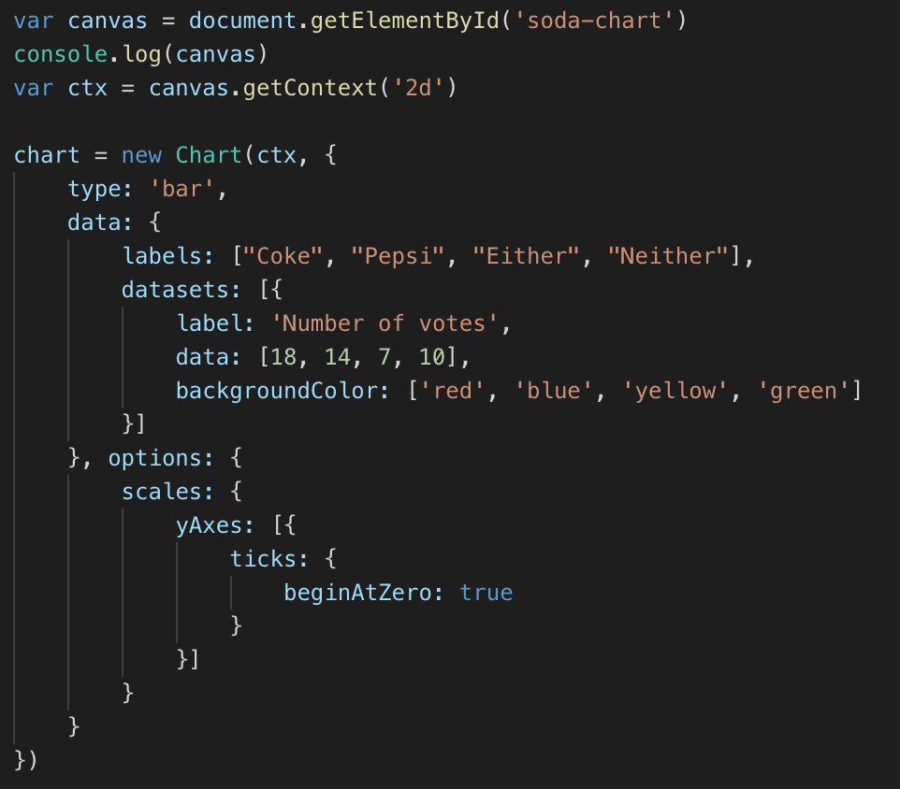
JavaScript
Find and draw chart on canvas

Slide 58
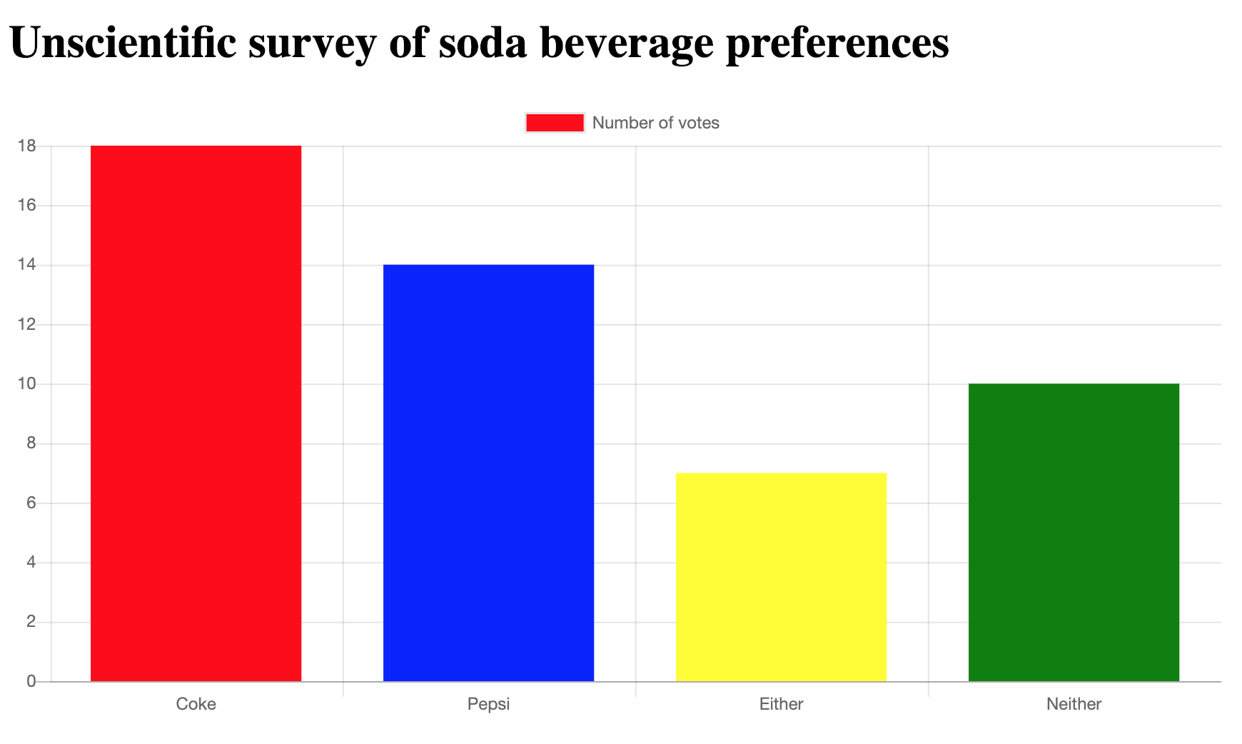
Chart - bars animate as drawn
https://claraj.github.io/week5-examples/chart_js/soda/hello_chart.html

Slide 59
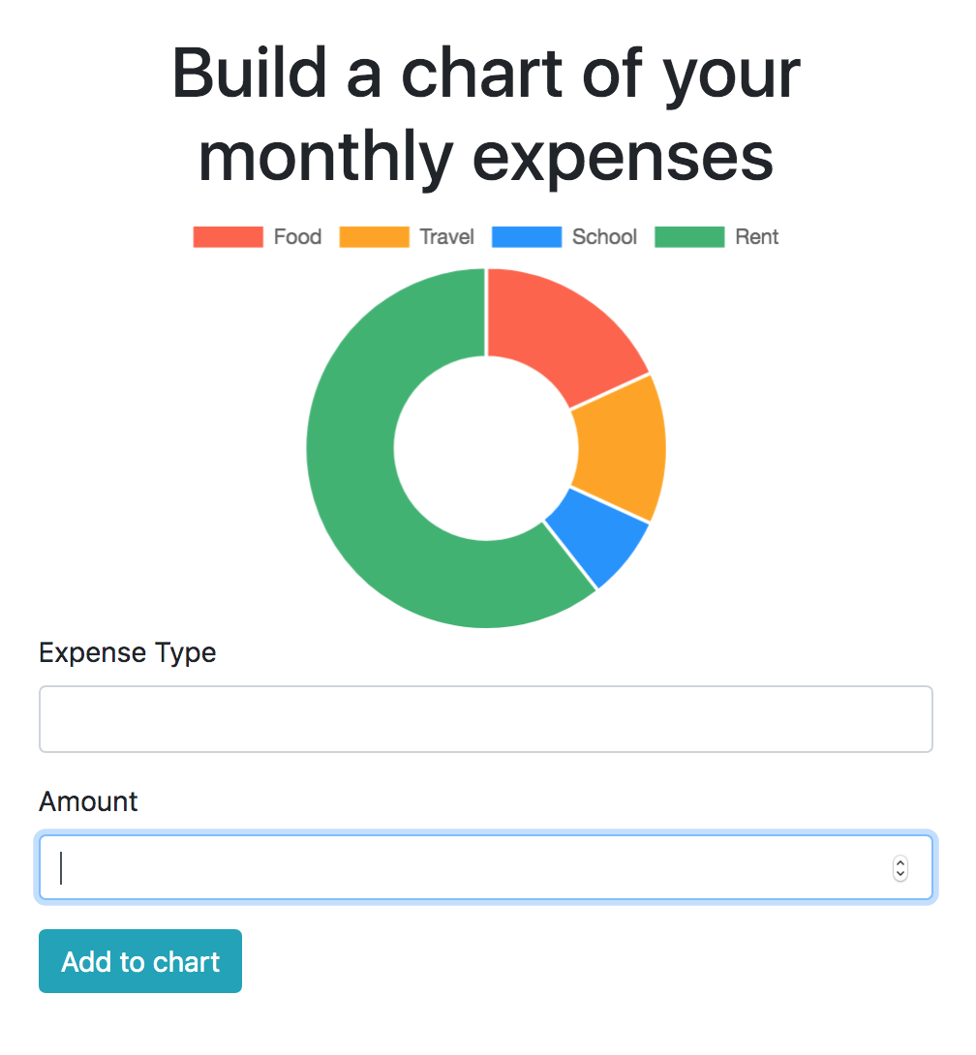
Updating a chart
Creating a chart of your expenses, by category
https://claraj.github.io/week5-examples/chart_js/expenses/spending.html

Slide 60
Live updates to chart - spending breakdown
Start with this page
https://github.com/claraj/week5-examples/blob/master/chart_js/expenses_template/expenses.html
And this script
https://github.com/claraj/week5-examples/blob/master/chart_js/expenses_template/expenses_chart.js
Save a copy of both files to the same directory
You'll finish the script to draw a doughnut chart, and update it as the user enters data
Look for the // TODO messages in expenses_chart.js

Slide 61
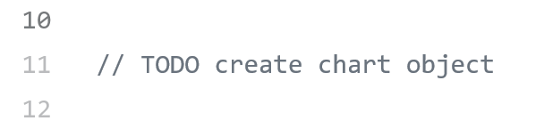
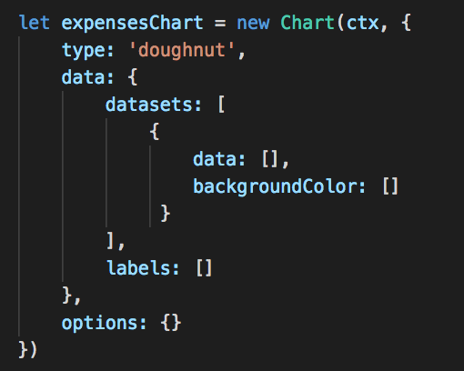
Create Chart object
First // TODO on line 11
Replace with this
data, labels are empty because there's no data yet - the user will create it

Slide 62

addExpenseToChart function
Add this code

Slide 63

Call the addExpenseToChart function in the addExpenseButton event listener

Slide 64

Test in browser
Add example expenses
Chart should update
Where are the colors?

Slide 65

Modify addExpenseToChart function
Add colors from the chartColors array
Cycle back to the start when all the colors are used

Slide 66

Tooltips
Test in the browser
Change the colors in the color array if you like
You can use #colors too, e.g. #45fa34
Notice you see Tooltips with the value of each segment

Slide 67

Adding an expense by pressing enter
Add this function
Test in the browser
Should only click the button if the focus is on one of the input elements, or the button

Slide 68
Lab 5
Create a basic drawing program
Optional - add more drawing tools and features
Create a information page about America's longest bridges
Draw a map, and chart using the data given

